Slide 1
2021-01-21
Ya, Ariyan, Pavol
Continual Learning with Generative Replay for Trajectory Prediction
(focus on pedestrian or vehicle or both)

Slide 2
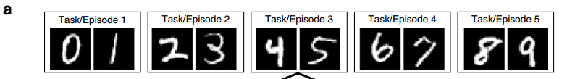
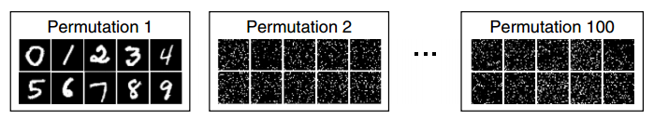
Introduce Continual Learning (three scenarios,two tasks)
two tasks
  - split MNIST task
  - permuted MNIST task
van de Ven, Gido M., and Andreas S. Tolias. "Three scenarios for continual learning." arXiv preprint arXiv:1904.07734 (2019).

Slide 3
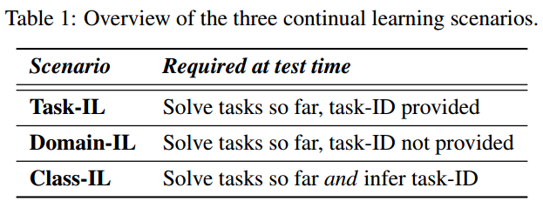
Introduce Continual Learning (three scenarios,two tasks)
three scenarios
van de Ven, Gido M., and Andreas S. Tolias. "Three scenarios for continual learning." arXiv preprint arXiv:1904.07734 (2019).

Slide 4
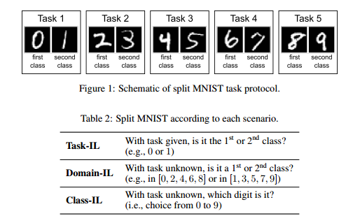
Introduce Continual Learning (three scenarios,two tasks)
Example
van de Ven, Gido M., and Andreas S. Tolias. "Three scenarios for continual learning." arXiv preprint arXiv:1904.07734 (2019).

Slide 5
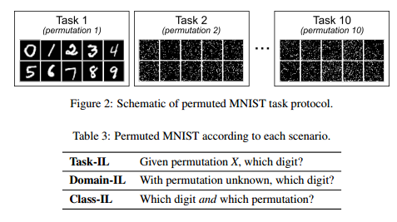
Introduce Continual Learning (three scenarios,two tasks)
Example
van de Ven, Gido M., and Andreas S. Tolias. "Three scenarios for continual learning." arXiv preprint arXiv:1904.07734 (2019).

Slide 6
Continual Learning Advantages (Why)
Online method
learn continuously and generalize well to new environments
But results maybe not the best one, wish it perform comparably (and sometimes outperforms) to state-of-the-art algorithms

Slide 7
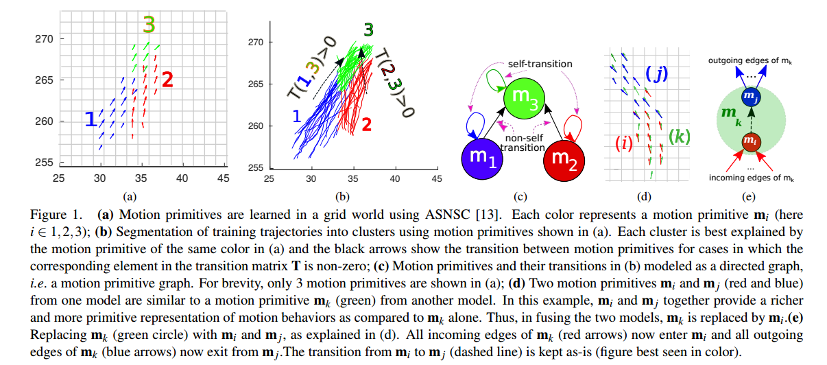
Data Preprocess (How to do)
motion primative (feature extraction)
Habibi, Golnaz, Nikita Jaipuria, and Jonathan P. How. "SILA: An Incremental Learning Approach for Pedestrian Trajectory Prediction." Proceedings of the IEEE/CVF Conference on Computer Vision and Pattern Recognition Workshops. 2020.

Slide 8
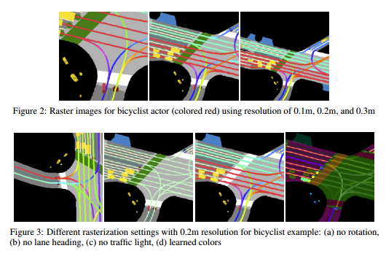
Data Preprocess (How to do)
image
vector layer,formed by a collection of polygons and lines that belong to a common type.
For example, in the case of map elements we have vector layer of roads, of crosswalks, and so on.
To rasterize vector layer into an RGB space, each vector layer is manually assigned a color from a set of distinct RGB colors that make a difference among layers more prominent.
Chou, Fang-Chieh, et al. "Predicting motion of vulnerable road users using high-definition maps and efficient convnets." arXiv preprint arXiv:1906.08469 (2019).

Slide 9
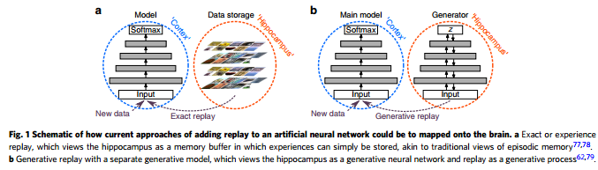
Data Preprocess (How to do)
Select
generator can directly to generate trajectory and trajectories also as the input
van de Ven, Gido M., Hava T. Siegelmann, and Andreas S. Tolias. "Brain-inspired replay for continual learning with artificial neural networks." Nature communications 11.1 (2020): 1-14.

Slide 10
Data Preprocess (How to do)
generator can directly to generate trajectory and trajectories also as the input
Can be used as a memory network?
Multiple Trajectory Prediction of Moving Agents with Memory Augmented Networks (2020PAMI)
MANTRA: Memory Augmented Networks for Multiple Trajectory Prediction (2020CVPR)

Slide 11
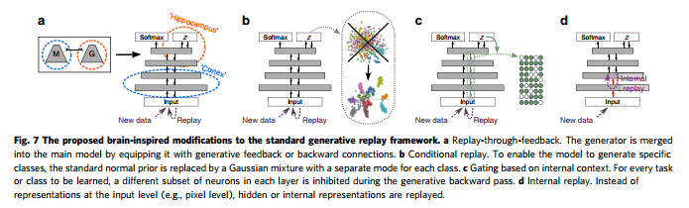
Data Preprocess (How to do)
generator can directly to generate trajectory and trajectories also as the input
Generative replay with a separate generative model, which views the hippocampus as a generative neural network and replay as a generative process
https://github.com/GMvandeVen/continual-learning
https://github.com/GMvandeVen/brain-inspired-replay
van de Ven, Gido M., and Andreas S. Tolias. "Generative replay with feedback connections as a general strategy for continual learning." arXiv preprint arXiv:1809.10635 (2018).

Slide 12
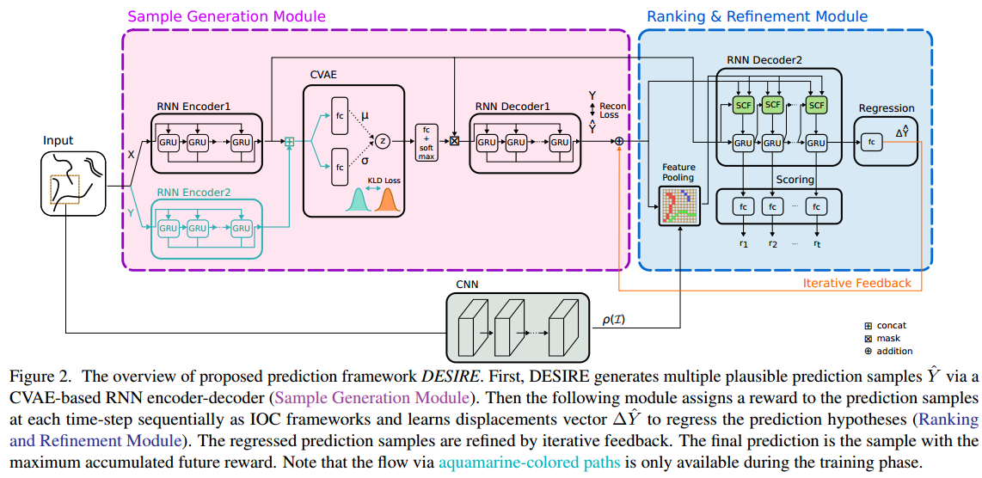
Model (How to do)
prove generate model have the power to generate good samples
Lee, Namhoon, et al. "Desire: Distant future prediction in dynamic scenes with interacting agents." Proceedings of the IEEE Conference on Computer Vision and Pattern Recognition. 2017.

Slide 13
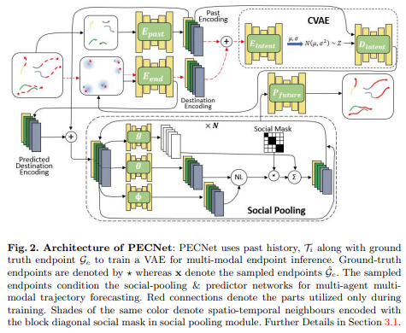
Model (How to do)
prove generate model have the power to generate good samples
Mangalam, Karttikeya, et al. "It Is Not the Journey but the Destination: Endpoint Conditioned Trajectory Prediction." ECCV2020 oral.

Slide 14
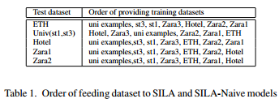
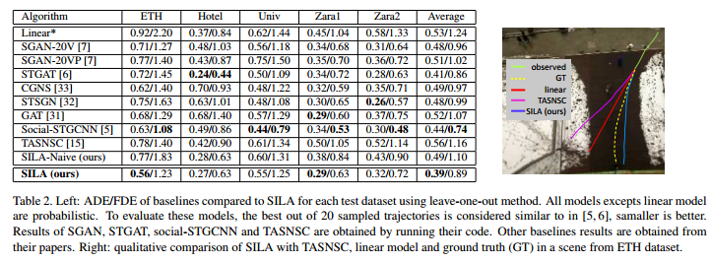
Experiments (How to do)
pedestrian datasets
compare with the SILA
Habibi, Golnaz, Nikita Jaipuria, and Jonathan P. How. "SILA: An Incremental Learning Approach for Pedestrian Trajectory Prediction." Proceedings of the IEEE/CVF Conference on Computer Vision and Pattern Recognition Workshops. 2020.

Slide 15
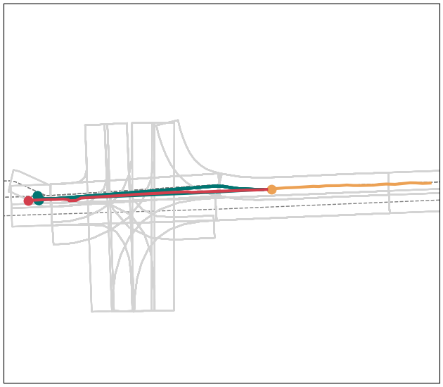
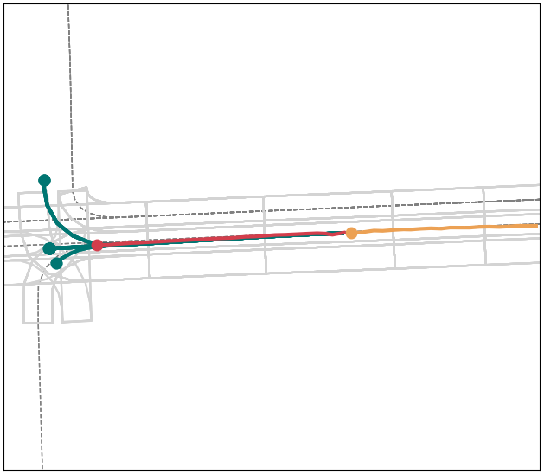
Experiments (How to do)
Argoverse or Lfty Level 5 (urban scenario)
compare with the state-of-the-art algorithms
split dataset into turn left (task 1), turn right (task 2) and straight (task 3)
as a domain-IL task, we first train separately on task1, task 2 and task3, then test on the whole dataset
compare with the state-of-the-art using this dataset

Slide 16
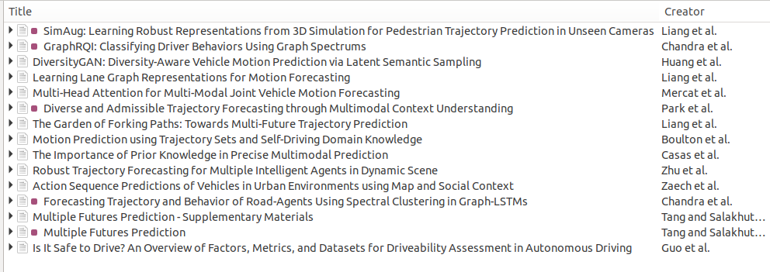
Experiments (How to do)
Argoverse or Lfty Level 5
compare with the state-of-the-art
Argoverse has more users and makes comparions easier
https://www.argoverse.org/index.html

Slide 17
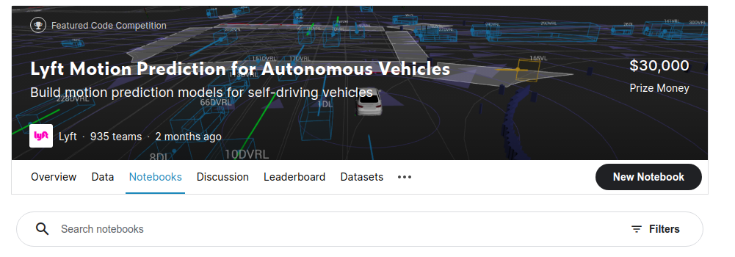
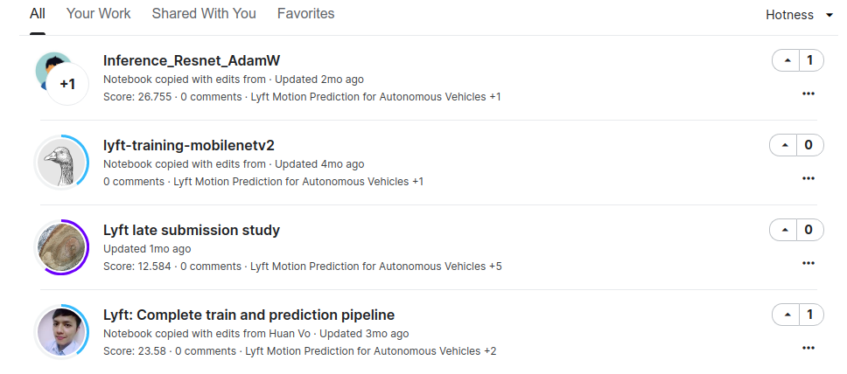
Experiments (How to do)
Argoverse or Lfty Level 5
compare with the state-of-the-art
Lyft organize a competition in Kaggle, and has more notebooks be released to tell us how to use it
https://www.kaggle.com/c/lyft-motion-prediction-autonomous-vehicles/notebooks

